Slide 1
Applicant Guide
Eligibility criteria and steps for applying to the ECSF, as hosted by Community Foundations of Canada and the community foundation network.

Slide 2
About the fund
The Emergency Community Support Fund (ECSF) is a $350 million investment made by the Government of Canada to support vulnerable populations as they manage the impacts of COVID-19.
The Government of Canada has partnered with Community Foundations of Canada, the Canadian Red Cross, and United Way Centraide Canada to deliver the ECSF.
While intermediaries are managing their respective funding streams separately, they are coordinating to ensure funding flows swiftly to organizations. See the infographic to learn more about what intermediary is funding and where you can apply.
This document intends to support qualified donee applicants interested in applying to Community Foundations of Canada’s ECSF program.

Slide 3
What partner should I apply to?
Community Foundations of Canada (CFC) | United Way Centraide Canada (UWCC) | Canadian Red Cross (CRC)
Local community foundations from across Canada will accept and assess applications from qualified donees through a centralized national portal. | Local United Way Centraide members will support qualified donees and, in some cases, non-profit organizations through an appropriate trustee relationship with a qualified donee, serving vulnerable populations. | National granting program for eligible non-profit organizations across Canada. As well, the Red Cross Preventing Disease Transmission Training and Equipment Program is open for all eligible charities, qualified donees and non-profit organizations.

Slide 4
What is a community foundation?
Benefits of working with community foundations
Community foundations are philanthropic organizations that direct grants, leadership and other investments toward community initiatives.
Across Canada, there are 191 community foundations, with more than 85% of communities having access to a community foundation.
The ECSF will be managed at the local community level by a network of community foundations, located across the country.
Visit our website to find the community foundation nearest you.
Knows the needs of the community.
Local decision making will help flow funds to address the most pressing needs of people in vulnerable populations

Slide 5
Eligible Organizations
CFC’s ECSF program will support qualified donees in running projects at the community level that serve vulnerable populations that have been especially affected by COVID-19.
Eligible projects include ongoing programs that meet the eligibility criteria outlined in this document. Qualified donees should be in touch with their local community foundation to learn more about available grant sizes.
Applicants will be required to share how their project assists vulnerable populations, the populations they serve, and the impact of the project on the community.
Examples of qualified donees include:
Registered charities
Registered Canadian amateur athletic associations
Registered Canadian municipalities
Registered municipal or public bodies performing a function of government in Canada
For more information, visit the Canada Revenue Agency
Charities Listing &
Qualified Donees

Slide 6
Eligible Projects & Expenses
The ESCF will provide immediate financial support for projects that are serving vulnerable populations as they manage the impacts of COVID-19. Qualified donees may apply for more than one grant, as long as each application describes a distinct project.
Specifically, eligible projects will:
Clearly address a pressing social inclusion or well-being need caused by COVID-19;
Serve one or more vulnerable groups (defined on next page);
Be carried out in a short timeframe with a reasonable budget, before March 31, 2021
Notes:
We encourage charities in the community who are serving vulnerable populations to apply to the Fund, through our community foundation or the local United Way Centraide.
Qualified donees may apply more than once (and to different funders if they wish) for different projects or for different aspects of a large project. They cannot receive funding for the same project or same aspect of a project from two intermediaries.
Grant applications to community foundations and local United Way Centraides will be assessed locally by our teams. Though community foundations and local United Way Centraides have separate funding streams as a result of our respective agreements with the Government of Canada, we are working together. The ECSF eligibility criteria, application and granting evaluation processes of CFC and UWCC’s are very similar. One difference between the two funding streams relates to grant amounts:
Community foundations’ funding stream has a grant maximum. In small communities of 15,000 residents or less, the maximum ECSF grant amount via CFC is $40,000. For larger cities and regions, the maximum grant amount via CFC is $75,000.
Local United Way Centraides have the flexibility to apply a minimum or maximum grant size depending on the local situation.

Slide 7
Vulnerable Populations
The fund will support projects that are serving vulnerable populations listed here.
Marginalized Communities in Canada
Racialized communities*
Indigenous peoples
Official Language Minority
Women & girls
LGBTQ2s+ communities
Newcomers (Permanent and temporary residents including immigrants and refugees)
*Arab, Black, Chinese, Filipino, Japanese, Korean, Latin American, South Asian, Southeast Asian, West Asian, Other racialized groups
Workers who are vulnerable
Caregivers
Essential Workers
Workers in the informal labour market
Temporary Foreign Workers
Children, youth and Elderly
Children and youth: Ages 0-29
Youth ageing out of care
Seniors & Elders - in and not in care

Slide 8
Vulnerable Populations Cont.
The fund will support projects that are serving vulnerable populations listed here.
Populations Requiring Specific Care or Supports
People experiencing homelessness
People with low income or living in poverty
People living with mental illness
People struggling with addiction
Persons with disabilities
People experiencing domestic or gender-based violence
People living in group homes or supportive living*
Prison populations (detained and incarcerated)
Veterans
Students (post-secondary)
* Under the age of 55

Slide 9
Eligible Projects & Expenses
Eligible Activities
All budget items must be project-related and must be incurred between April 1, 2020 and March 31, 2021.
Eligible expenditures include reasonable and essential expenditures to carry out the project. These include:
Wages and employment-related costs for existing or additional staff;
Fees for professional service;
Disability supports for staff of the grant recipient;
Materials and supplies;
Printing and communication;
Travel costs;
Utilities;
Insurance;
Rental of premises;
Lease, purchase and maintenance of equipment;
Performance monitoring and reporting costs;
Data collection;
Knowledge development activities; and
Other administrative costs associated with the project.
Eligible activities for funded projects can include things such as:
Community outreach and engagement
Delivering new models, tools, programming, services or resources
Developing new models, tools, programming, services or resources
Disseminating information and knowledge
Volunteer engagement and recruitment

Slide 10
Examples of Eligible Projects
Please visit the Appendix for additional examples of eligible projects and services
Addition of meal service staff at a women’s shelter to meet public health guidelines
Technology purchase and service enabling seniors in-residence to connect with their families virtually
Increased staffing and supplies at a shelter for women and children fleeing violence
Preparing and delivering food for persons with disabilities
Remote arts programming for vulnerable youth
Procurement and delivery of educational materials to Aboriginal Friendship Centre families
Development of online social skills curriculum for individuals with special needs, replacing in-person programming

Slide 11
Ineligible Expenses
The following expenditures are ineligible, and will not be supported by the ECSF:
Purchase of real property (land or building)
Expenses incurred prior to April 1, 2020
Expenses incurred after March 31, 2021
Any expenses that are covered by another funding source (including the Government of Canada, Canadian Red Cross and United Way Centraide Canada or their local affiliates). Projects may receive funding from other sources, but those funds may not cover the same expenses as this grant.
Ineligible projects include:
Projects that are designed for fundraising purposes,
Profit generating projects or activities,
Any activity taking place outside of Canada
Projects that have received funding through another ECSF intermediary (Red Cross or United Way)
Projects may receive funding from other sources, but those funds may not cover the same expenses as this grant.

Slide 12
Timeline & How to Apply
The community foundation network is accepting applications beginning on May 19, 2020.
Applications must be submitted before July 27, 2020 for activities occurring between April 1, 2020 and March 31, 2021.
If you are eligible and would like to apply, please reach out to your local community foundation to discuss your project and application.
When you are ready to apply, please visit the Application Portal. Please review this video (link forthcoming) for instructions and help with submitting your application.
If your organization is located in an area that is not served by a community foundation and you are interested in applying, please contact CFC at covid19@communityfoundations.ca

Slide 13
Application, Grant & Reporting Summary
If you decide to apply, the online portal will allow you to create & submit your application.
Eligibility
Quiz
Eligibility
See next slide
Grant Application
Five sections
Approximately 15 minutes to complete
Electronic
Banking Info
Banking information
Voided Cheque
Grant Agreement
Terms & Conditions
Confirming Reporting Requirements
Grant Reporting
Due by March 31st, 2021
Simple Reporting

Slide 14
Grant Decision Turnaround Times & Adjudication
As this is an emergency fund, we have developed a responsive granting process. Applications will be assessed on a weekly basis.
Qualified
Donee
Application Submitted
Application Under Review
Grant Decision*
Grant Agreement**
Funds
Transferred
Application Review
Regular
Reviews
Local grant review teams
Regular reviews of applications
Potentially awarding a different amount than requested (based on number of applications vs available funding)
Application
Validation
Timely
Validation
Ensure its a qualified donee
Grant amount
No purchase of real estate
Proposed activity is approved COVID 19 response
Serves at least 1 vulnerable population

Slide 15
Eligibility Quiz
The community foundation network is accepting applications beginning on May 19, 2020.
Eligibility Questions | Yes/No
Is your organization a qualified donee (such as a registered charity, Canadian amateur athletic association, municipality, or municipal or public body performing a function of government in Canada)?
Did you receive/apply for funding from the Government of Canada, another ECSF intermediary (Canadian Red Cross, United Way Centraide Canada) or from a provincial, territorial and municipal government to cover the same project costs?
Do you grant permission for this application and contact details to be shared with the Government of Canada, United Way, Community Foundations Canada and Canadian Red Cross, for consideration and coordination of funding?

Slide 16
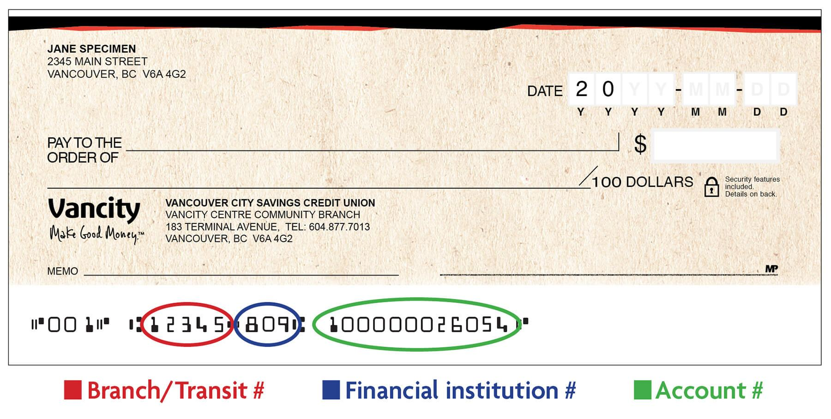
Grant Agreement & EFT Information
If your application is successful, your local community foundation partner or in areas where there is not a participating community foundation, CFC will collect a signed grant agreement and banking information.
Grant Agreement:
Section 1: Confirming Purpose of Grant
Section 2: Acknowledgements
Section 3: Use of Funds/Reporting
View and sign the grant agreement.
Electronic Fund Transfer (EFT):
Bank Information (Transit/Routing/Institution #)
Voided Check*
Notes:
10 max business days (2 weeks)

Slide 17
Appendix & Resources

Slide 18
Appendix & Glossary of Terms
Additional Examples of Eligible Projects (slide 10)
Volunteer-based home delivery of groceries and medications.
Transportation services, such as those driving seniors or persons with disabilities to appointments.
Scaling up help lines that provide information and support.
Helping vulnerable Canadians access government benefits.
Delivering training and supplies to volunteers.
Replacing in-person, one-on-one contact and social gatherings with virtual contact through telephone, texts, teleconferences or the Internet.
Eligible service categories on the following page.

Slide 19
Services | Descriptions
Food security | Prepared meals, delivery service
Financial wellness | Financial literacy or coaching; access to income supports
Home care/personal support services | For seniors and persons with disabilities
Health and hygiene | Health information; access to medication; personal hygiene & medical supplies
Information and navigation | Providing information; navigating community supports;
Legal support | Tools and resources; legal clinic for community members, tenants etc.
Mental health and wellness | Peer support; crisis support
Shelter | Housing, rent support
Personal safety | Information; access to violence and abuse support; violence and abuse prevention
Social inclusion and learning | Friendly conversation; social activities; learning activities
Transportation and mobility | Access to safe transport to essential appointments or errands

